Slide 1

LSH & Min Hashing
Master: Dr.Bijani
Presented by: Melika Bahmanabadi
June 2020

Slide 2
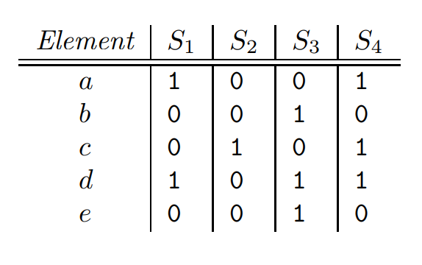
Matrix Representation of Sets (characteristic matrix)
S1 = {a, d}, S2 = {c}, S3 = {b, d, e}, S4 = {a, c, d}
2

Slide 3
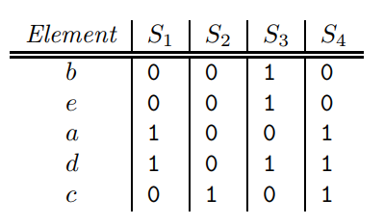
Minhashing
h(S1) = a, h(S2) = c, h(S3) = b, h(S4) = a
3

Slide 4
Minhashing and Jaccard Similarity
SIM(S, T ) = |S ∩ T | / |S ∪ T |
Rows can be divided into three classes
1. Type X rows have 1 in both columns.
2. Type Y rows have 1 in one of the columns and 0 in the other.
3. Type Z rows have 0 in both columns.
Since the matrix is sparse, most rows are of type Z.
SIM(S1, S2) = x / (x + y)
4

Slide 5
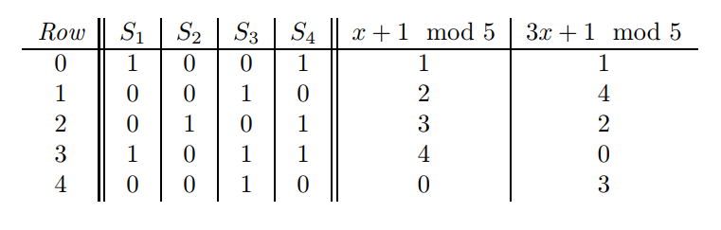
Minhash Signatures
h(S1) = h(S2) is x / (x + y)
5

Slide 6
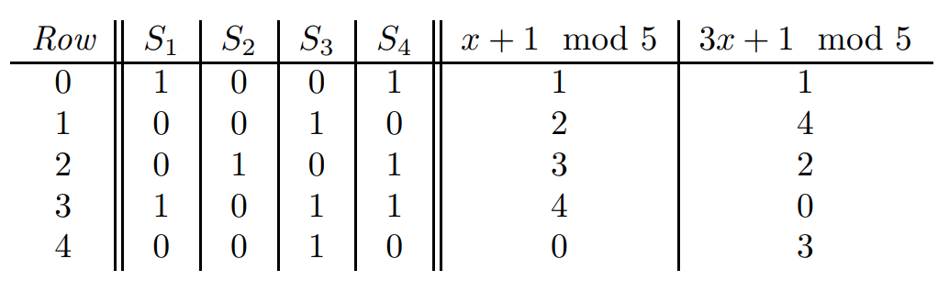
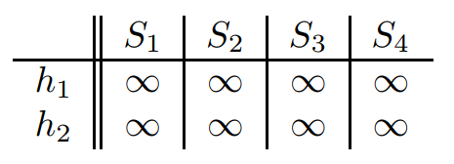
Minhash Signatures
6

Slide 7
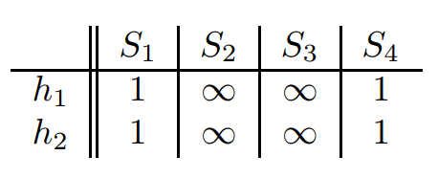
Minhash Signatures
Row 0 :
7

Slide 8
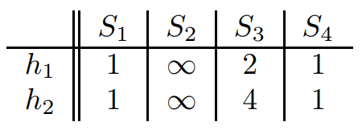
Minhash Signatures
Row 1 :
8

Slide 9
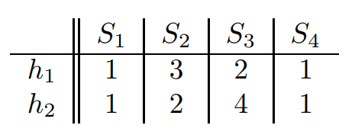
Minhash Signatures
Row 2 :
9

Slide 10
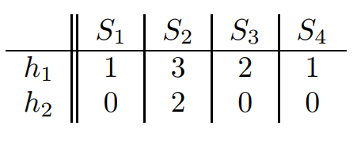
Minhash Signatures
Row 3 :
10

Slide 11
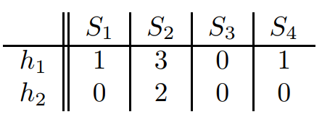
Minhash Signatures
Row 4 :
11

Slide 12
LSH (Locality-Sensitive Hashing)
LSH allows us to focus on pairs that are likely to be similar, without having to look at all pairs.
The number of pairs of documents may be too large, so it is impossible to find the pairs with greatest similarity efficiently.
12

Slide 13
LSH for Minhash Signatures
In each bucket just the pairs that are similar put together.
The pairs that aren`t similar but put in a bucket => False positive.
The pairs that are similar but don`t put in a bucket => False negative.
Ideal status is when both of false positive and false negative are 0.
13

Slide 14
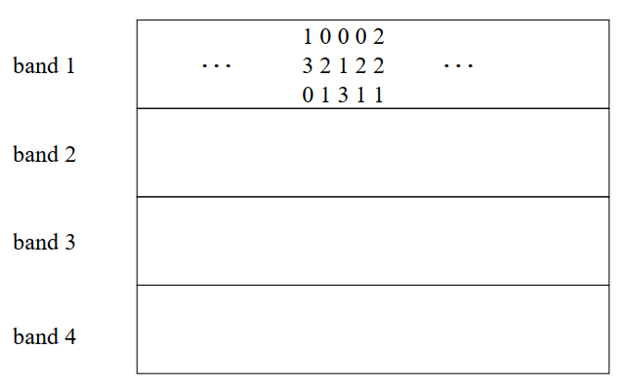
LSH for Minhash Signatures
An effective way to choose the hashings is to divide the signature matrix into b bands consisting of r rows each.
For each band, there is a hash function that takes vectors of r integers and hashes them to some large number of buckets.
14

Slide 15
LSH for Minhash Signatures
We show a signature matrix of 12 rows divided into 4 bands of 3 rows each. The 2th and 4th of the explicitly shown columns each have the column vector [0, 2, 1] in the first band.
so they will definitely hash to the same bucket in the hashing for the first band.
15

Slide 16
LSH for Minhash Signatures
We show a signature matrix of 12 rows divided into 4 bands of 3 rows each. The 2th and 4th of the explicitly shown columns each have the column vector [0, 2, 1] in the first band.
so they will definitely hash to the same bucket in the hashing for the first band.
16

Slide 17
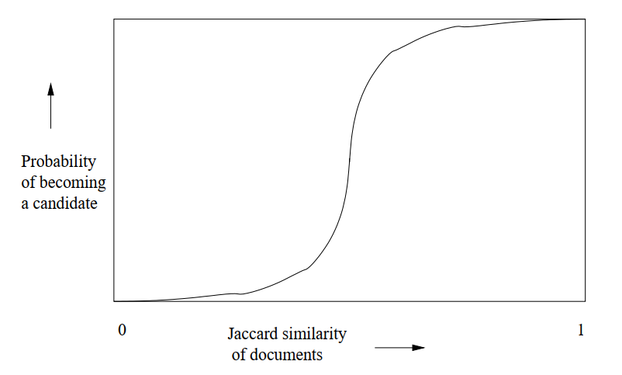
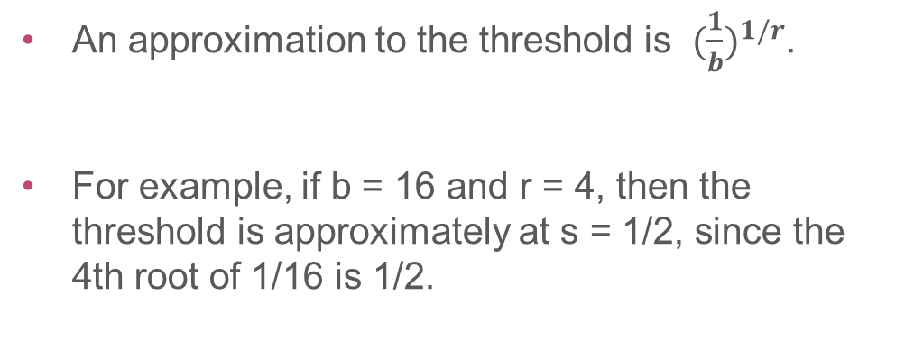
The S-curve
An approximation to the threshold is ${(\frac{1}{b})}^{1/r}$.
For example, if b = 16 and r = 4, then the threshold is approximately at s = 1/2, since the 4th root of 1/16 is 1/2.
17

Slide 18
Distance Measures
Distances
Jaccard
Hamming
Euclidean
Cosine
Edit
18

Slide 19
Jaccard Distance
The Jaccard similarity is a measure of how close sets are.
The Jaccard distance is 1 − Jaccard similarity : d(x, y) = 1 − SIM(x, y)
d(x, y) is nonnegative because the size of the intersection cannot exceed the size of the union.
d(x, y) = 0 if x = y, because x ∪ x = x ∩ x = x.
d(x, y) = d(y, x) because both union and intersection are symmetric; i.e., x ∪ y = y ∪ x and x ∩ y = y ∩ x.
19

Slide 20
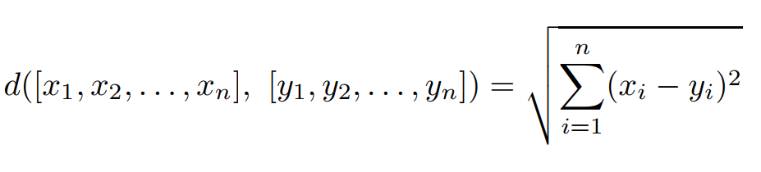
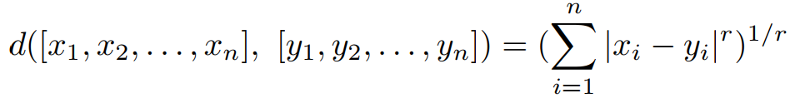
Euclidean Distances
An n-dimensional Euclidean space is one where points are vectors of n real numbers.
It is called L2-norm and show by this formula:
Also we can define the Lr-norm by this formula:
20

Slide 21

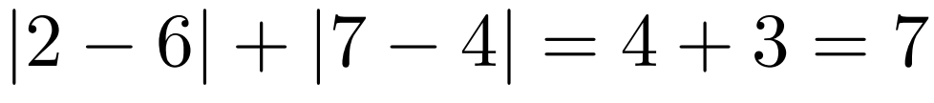

Euclidean Distances
The L∞-norm is defined as the maximum of |xi − yi| over all dimensions i.
Example: Consider the two-dimensional Euclidean space the points (2, 7) and (6, 4).
The L2-norm :
The L1-norm :
The L∞-norm :
21

Slide 22
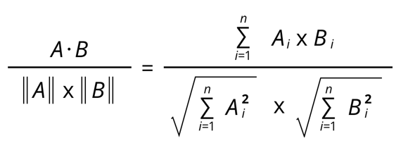
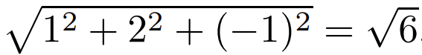
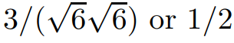
Cosine Distance
It uses in spaces where points are vectors with integer components or Boolean (0 or 1) components and compute via this formula :
Example: Let our two vectors be x = [1, 2, −1] and y = [2, 1, 1].
The dot product x.y is 1 × 2 + 2 × 1 + (−1) × 1 = 3.
x has L2-norm :
Thus, the cosine of the angle between x and y is :
The angle whose cosine is 1/2 is 60 degrees.
22

Slide 23
Edit Distance
This distance makes sense when points are strings.
The distance between two strings x = x1x2 · · · xn and y = y1y2 · · · ym is the smallest number of insertions and deletions of single characters that will convert x to y.
Example: The edit distance between x and y is 3. To convert x to y:
x = abcde
y = acfdeg
Delete b.
Insert f after c.
Insert g after e.
No sequence of fewer than three insertions and/or deletions will convert x to y. Thus, d(x, y) = 3.
23

Slide 24
Edit Distance
Another way to define and calculate the edit distance d(x, y) is to compute a longest common subsequence (LCS) of x and y.
d(x,y) = |x| + |y| - 2 |LCS|
Example: Consider these tow strings.
x = abcde
y = acfdeg
Their LCS is : acde
|x| = 5
|y| = 6
|LCS| = 4
d(x,y) = 5 + 6 – 2*4 = 3
24

Slide 25
Edit Distance
Example: Consider these tow strings.
x = aba
y = bab
Their LCS is : ab
|x| = 3
|y| = 3
|LCS| = 2
d(x,y) = 3 + 3 – 2*2 = 2
25

Slide 26
Hamming Distance
Given a space of vectors, we define the Hamming distance between two vectors to be the number of components in which they differ.
Example: The Hamming distance between these tow vectors is 3.
10101
11110
26

Slide 27
Locality-Sensitive Functions
We shall consider functions that take two items and render a decision about whether these items should be a candidate pair.
In many cases, the function f will “hash” items, and the decision will be based on whether or not the result is equal.
we shall use f(x) = f(y) to mean that f(x, y) is “yes; make x and y a candidate pair”.
We also use f(x) ≠ f(y) to mean “do not make x and y a candidate pair unless some other function concludes we should do so.”
27

Slide 28
Locality-Sensitive Functions
A collection of functions of this form will be called a family of functions.
Let d1 < d2 be two distances according to some distance measure d.
A family F of functions is said to be (d1, d2, p1, p2)-sensitive if for every f in F:
1. If d(x, y) ≤ d1, then the probability that f(x) = f(y) is at least p1. 2. If d(x, y) ≥ d2, then the probability that f(x) = f(y) is at most p2.
28

Slide 29
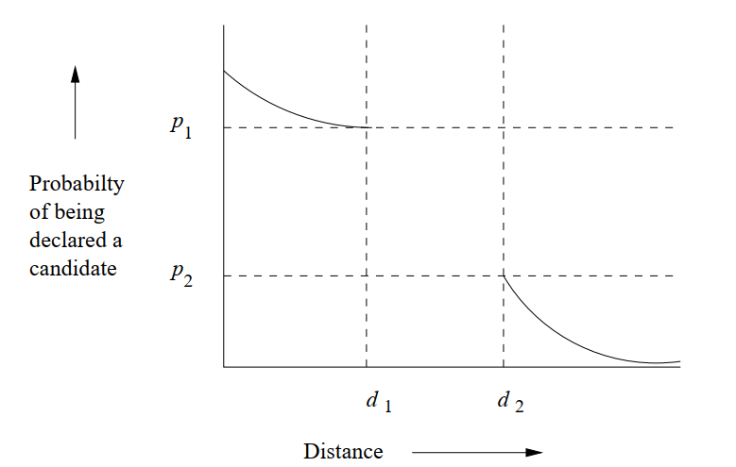
Locality-Sensitive Functions
29

Slide 30
Thank you
Melika.Bahmanabadi99@gmail.com
https://github.com/MelikaBahmanabadi
https://www.linkedin.com/in/melika-bahmanabadi-6729aa19a/

